Slide 1

Topic:- Unit - 2 SEARCH ENGINE OPTIMIZATION (SEO)

Slide 2
TERMINOLOGIES
1) QUALITY TRAFFIC – It is an outcome of providing the right content and experience for our visitor. Traffic, leads generated, interactions, and sales are a few ways companies measure the success of their website.
2) QUANTITY TRAFFIC - Once we have the right people clicking through from those search engine results pages (SERPs), more traffic is better.
3) ORGANIC TRAFFIC - Organic traffic is any traffic that we don't have to pay for.
4) KEYWORD – A phrase for which one would like to rank one on google.
5) DOMAIN – Domain names are used in URLs to identify particular web pages.
6) LINK BUILDING - Link building is the practice of building one-way hyperlinks (also known as “backlinks”) to a website with the goal of improving search engine visibility.

Slide 3
WHAT IS SEO ?
Search Engine Optimization, which is the practice of increasing the quantity and quality of traffic to our website through organic search engine results.
It’s the practice of increasing both the quality and quantity of website traffic, as well as exposure to our brand, through non-paid (also known as "organic") search engine results.
It is a digital marketing strategy that focuses on our website's presence in search results on search engines like Google.
One can use different tactics to increase its visibility in search results.

Slide 4
WHY SEO IS IMPORTANT ?
The majority of search engine users are more likely to click on one of the top 5 suggestions in the search engine results pages (SERPS). To take advantage of this and gain visitors to our web site or customers to our online store, our website needs to appear in one of the top positions.
SEO is not only about search engines but good SEO practices improve the user experience and usability of a web site.
Users trust search engines and having a presence in the top positions for the keywords the user is searching, increases the web site’s trust.
SEO is good for the social promotion of our web site. People who find our web site by searching on Google or Yahoo are more likely to promote it on Facebook, Twitter, or other social media channels.

Slide 5
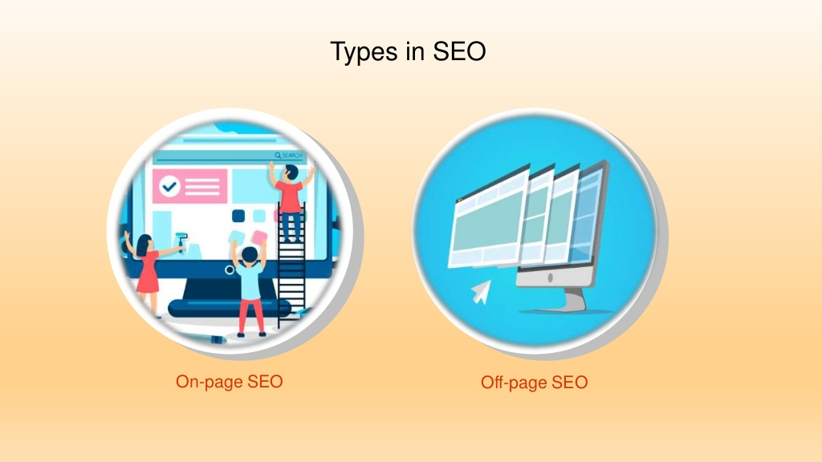
TYPES OF SEO

Slide 6
ON – PAGE SEO
On-page SEO (also known as on-site SEO) refers to the practice of optimizing web pages to improve a website's search engine rankings and earn organic traffic.
It is a technique of SEO in which we can done on the pages of the website itself.
On-page SEO refers to the factors through which we can control our own website.
In addition to publishing relevant, high-quality content, on-page SEO includes optimizing our headlines, HTML tags and images.
It also means making sure our website has a high level of expertise, authoritativeness, and trustworthiness.

Slide 7
OFF - PAGE SEO
Off- page optimization is a technique of SEO in which we covers activity that takes place elsewhere outside the website.
In the Off- page SEO we doesn’t change the website. We change back linking options.
Off-page SEO refers to activities you can perform outside the boundaries of your website. The most important are:
Link Building
Social Media Marketing
Brand Mentions

Slide 8
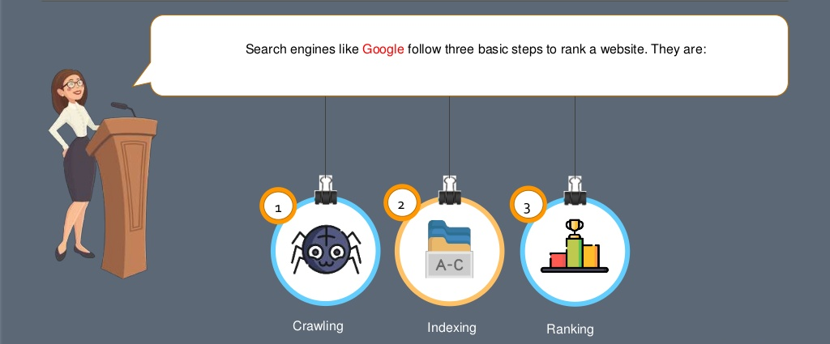
HOW DOES SEARCH ENGINES WORK ?

Slide 9
Crawl: Scour the Internet for content, looking over the code/content for each URL they find.
Index: Store and organize the content found during the crawling process. Once a page is in the index, it’s in the running to be displayed as a result to relevant queries.
Rank: Provide the pieces of content that will best answer a searcher's query, which means that results are ordered by most relevant to least relevant.

Slide 10
DO’S AND DONT’S OF SEO
DO’S | DON’T’S
Get backlinks from relevant sites | Avoid backlinks from irrelevant sites
Use keywords in titles and tags in order to rank high in search engines | Do not duplicate title on multiple web pages
Write engaging and latest content | Do not copy other website’s content
Do keyword research | Avoid keyword stuffing
Make your websites user- friendly and mobile friendly | Avoid over optimizing of anchor text

Slide 11
What is GOOGLE ANALYTICS
• Free service offered by Google
• The most widely used website statistics service*
• Provides statistics and reports about visitors and
transactions on a website
• At-a-glance dashboard view as well as detailed reports

Slide 12
How does Google Analytics work?
• Establish a User ID and password at
google.com/analytics
• Google then provides a “page tag” or Google Analytics Tracking Code that needs to be added to each page of a website.
• This tag collects data and sends it back to the Google servers for processing.

Slide 13
How can it help a website?
• Helps with development and optimization of landing pages
– How relevant were they to the visitor?
• Identifies navigation challenges that may prevent visitors from getting to your goal
• Optimization of AdWords performance
– keywords
– timing
– geographic differences

Slide 14
Keywords Overview
• There are two types of traffic that come to a site through search engines; organic (unpaid) and paid. By reviewing the keywords users are entering into search engines, web masters are able to get an overview of the organic traffic that is coming through their site.
• if a keyword has a high ‘average time on site’ associated with it, the visit was probably of more value to the user than a visit resulting from a keyword with a low average time on site.
• Although Google Analytics lets you do a multitude of comparisons on a website’s data it does not allow you to directly compare against other sites.

Slide 15
Types Of SEO
White Hat SEO
Black Hat SEO
Grey Hat SEO- includes both white hat and black hat SEO

Slide 16
White Hat SEO
Follows google guideline and algorithm.
Techniques that search engine recommend as a part of good design.
Slow in process but are long lasting.
Practices guideline are strictly given by google
Most commonly practiced techniques are publishing good quality content , HTML Optimization and restructuring of website.

Slide 17
Black Hat SEO
Don’t allow google guidelines and algorithm.
Techniques that search engine do not approve and attempt.
Refers to SEO practices that are violation of google’s webmaster guidelines.
Shortcoming for higher rank.
Also Called spamdexing.
Most common Black hat SEO techniques include spam links, keyword stuffing, cloaking, hidden text, and hidden links.
Traffic generated through these practices does not last nor are the rankings able to maintain their position on search engine research pages for longer time.

Slide 18
THANK YOU

